Slide 1
CSE 2102: Introduction to Software Engineering
Software Verification
Black-box Testing

Slide 2
Black-box testing
Also known as functional testing
Based on the definition of what the program is supposed to do.
Test cases may be derived from specifications
Complete coverage may be applied to black-box testing, focus on conditions to test particular code

Slide 3
Black-box testing (contd..)
Example specification
The program receives as input a record describing
an invoice. (A detailed description of the format of
the record is given.) The invoice must be inserted
into a file of invoices that is sorted by date. The invoice
must be inserted in the appropriate position: If other
invoices exist in the file with the same date, then the
invoice should be inserted after the last one. Also,
some consistency checks must be performed: The program
should verify whether the customer is already in a
corresponding file of customers, whether the customer’s
data in the two files match, etc.

Slide 4
Black-box testing (contd..)
Did you consider these cases?
• An invoice whose date is the current date
• An invoice whose date is before the current date
(This might be even forbidden by law)
This case, in turn, can be split into the two
following subcases:
• An invoice whose date is the same as that
some existing invoice
• An invoice whose date does not exist in any
previously recorded invoice
• Several incorrect invoices, checking different types of
inconsistencies

Slide 5
Systematic black-box techniques
Syntax-driven testing
Decision table based testing
Cause-effect graph based testing

Slide 6
Syntax driven testing
Applicable to software whose input is formally described by a grammar
  For example, compilers
Requires a complete formal specification of syntax of language.
Specification is used to generate test cases.
  For example, sample programs to be compiled.

Slide 7
Syntax driven testing (contd..)
Apply complete coverage principle to all grammar rules
Generate a test case for each rule of the grammar
  The test case might also cover other rules
Specification is formal, and test generation can be automated
Minimal test set: Program(s) that exercise all statements of the language with minimal or no repetition

Slide 8
Decision-table based testing
Applicable when a specification is described by a decision table
Tables describe how combinations of inputs generate different outputs
Ideally constructed during design phase, if not, then during testing phase:
  Useful to both developers and testers.
  Increase confidence that important business rules are documented.
Notes:
Decision table based testing is useful, when the specification of a program is given by a decision table. In this case, a decision table indicates how different combinations of inputs generate different outputs. This is an approach that is simple to understand, and also supports automatic derivation of test cases using specifications described using decision tables. Decision table based testing is useful in the context of data processing applications.

Slide 9
Decision Table-based Testing
“The word-processor may present portions of text in three
different formats: plain text (p), boldface (b), italics (i). The
following commands may be applied to each portion of text:
make text plain (P), make boldface (B), make italics (I),
emphasize (E), super emphasize (SE). Commands are available to
dynamically set E to mean either B or I (we denote such
commands as E=B and E=I, respectively.) Similarly, SE can be
dynamically set to mean either B (command SE=B) or I
(command SE=I), or B and I (command SE=B+I.)”

Slide 10
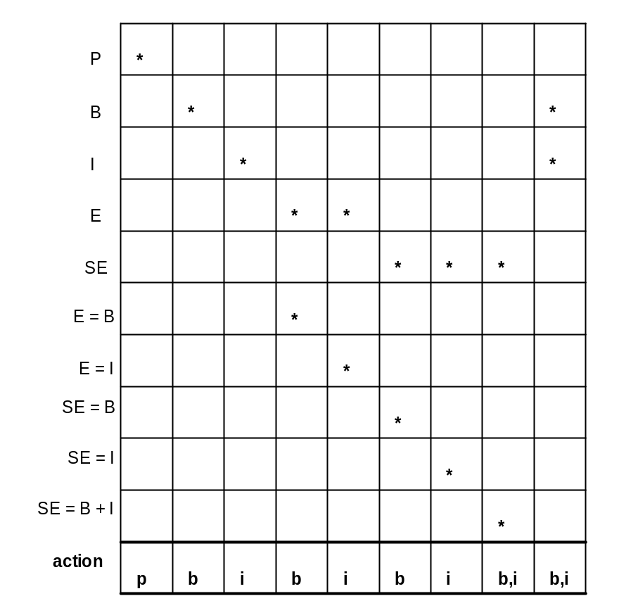
Decision Table-based Testing
Rows represent the conditions/inputs.
Columns represent rules (actions,
that are the result of conditions).
Rule represented in the leftmost
column of the table shows that
condition P generates output p.
To avoid clutter, the table shows only
true conditions.

Slide 11
Decision Table-Based Testing – Advantages
Provides structure to complex business rules.
  Considers interactions.
Detects combinations that otherwise would not be found:
  Each column corresponds to a rule in the business logic that describes a unique combination of circumstances.
Clarify requirements, find those that are illogical.
Write test cases, at least one test case per column gives full coverage of business rules.

Slide 12
Cause Effect Graphs
Based on a formal way of structuring complex input-output specifications
Inputs and outputs are transformed into Boolean values
Program transformation converted into a Boolean function
Notes:
Based on the formal technique known as cause-effect graphing. To apply this technique, the program is specified formally using cause-effect graphs. In order to specify the program formally using cause-effect graphs, we must transform the inputs into Boolean values, outputs to Boolean values, and the program is then a Boolean transformation function which accepts Boolean values as input, and transforms these values into Boolean values at the output.

Slide 13
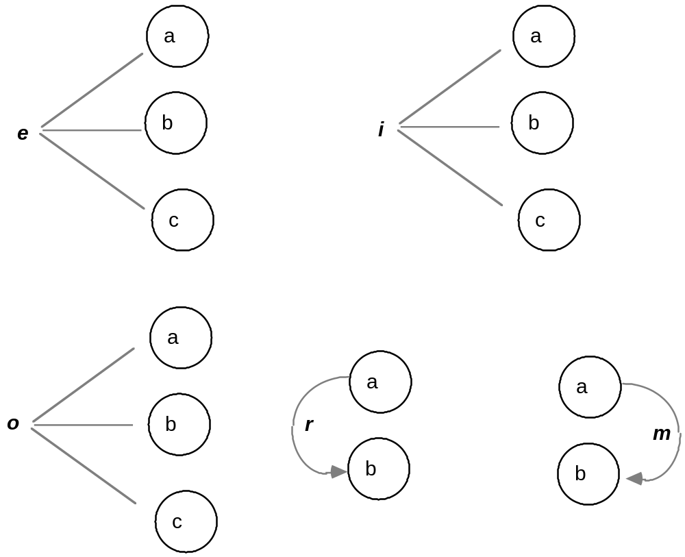
Cause Effect Graphs – Additional Constraints
at least
one
at most
one
requires
one and only
one
masks

Slide 14
Testing boundary conditions
Testing criteria partition input domain in classes, assuming that behavior is "similar" for all data within a class
Some typical programming errors occur at the boundary between different classes
  For example, if x < y used instead of x <= y, case of x = y may not get tested.
Suggestion: Test software using values both inside and at boundaries of groups.
Applies to both white and black-box testing
Notes:
In input domain partitioning, we partition the domain in such a way that the behavior of the program is similar in each sub domain. However, it is commonly observed that many programming errors are committed at the boundaries between the domains. For example, we may use < instead of <= etc. If we recall the example of finding an element through the table of elements, instead of using <= we had used less than. Thus, in addition to using a representative test case from each subdomain, we should also test using test cases at the boundaries between the domains. Thus, this principle should be used in both black and white-box testing.

Slide 15
The oracle problem
How to inspect the results of test executions to reveal failures?
Oracles are required at each stage of testing
Automated test oracles are required for running large amounts of tests
Oracles are difficult to design - no universal recipe
Notes:
So far, we have focused on test data selection, such that, how to test the program using different input values such that we have a reasonable confidence in its correctness. However, in order to gain this reasonable confidence in its correctness, we must be able to verify that the outputs produced by the input value that we selected is indeed correct. Sometimes, the specification of the problem will indicate what the output value should be. This would be the case for most programs which perform mathematical computations. However, in certain cases, the specification will not state what the output values should be. For example, when we are designing an air traffic control system, and testing it, we should make sure that the routes generated by the system should not result in aircraft collisions. However, the only way to test this is to run the system on real aircrafts, which is quite dangerous. Thus, in general, designing an oracle, to determine whether an input test data produces an acceptable output is a very hard problem. Sometimes, the specification may state the properties that the output must satisfy rather than actually stating the value. In these cases, whether the output satisfies the property may be easier to verify.
Unless we have an oracle, it is difficult to automate the execution of a large number of test cases, since manual verfication of each test case is costly.

